Slide 1
AR Indoor Navigation for
SKKU Suwon campus
team E: 김현호 마준서 안정민 조민구

Slide 2
Contents
UI Development
Location correction
AR Marker recognition in Unity environment
AR Anchor test
To-do List Until Next Week
2/9

Slide 3
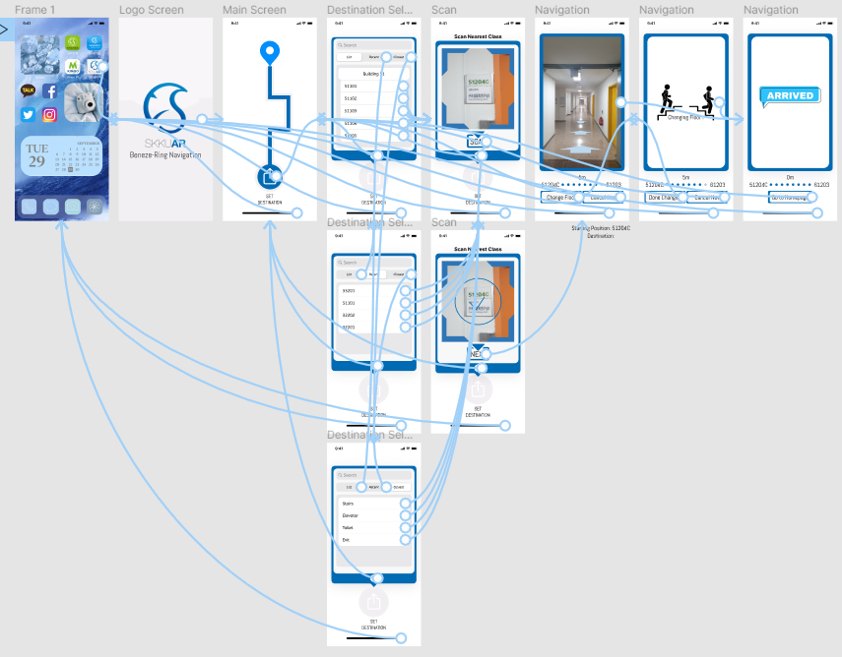
UI Development
3/9

Slide 4
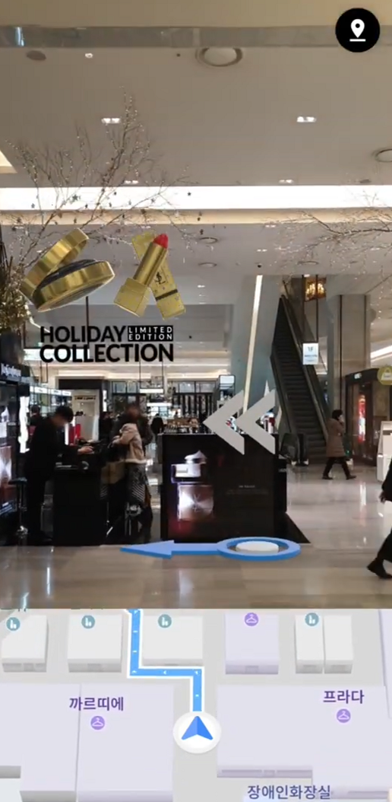
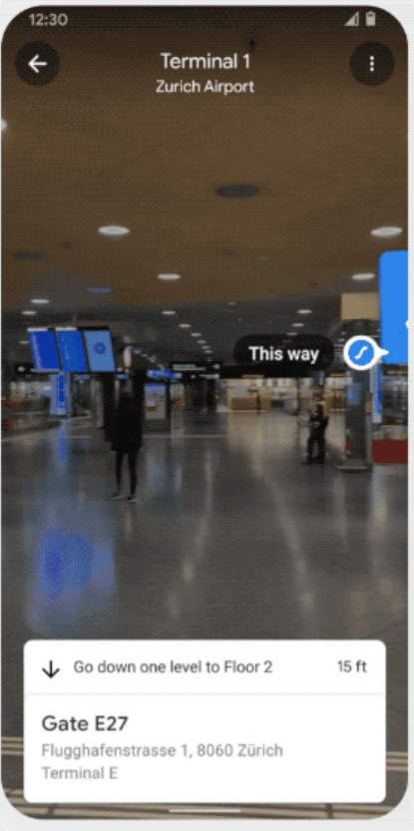
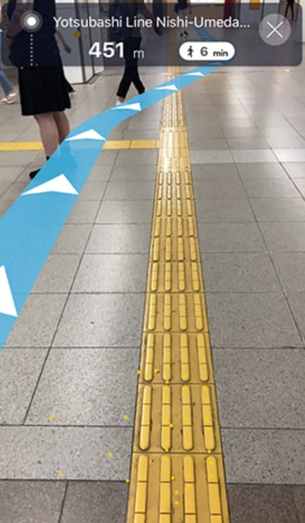
UI Development
3/9
Naver
Google
Osaka Metro

Slide 5
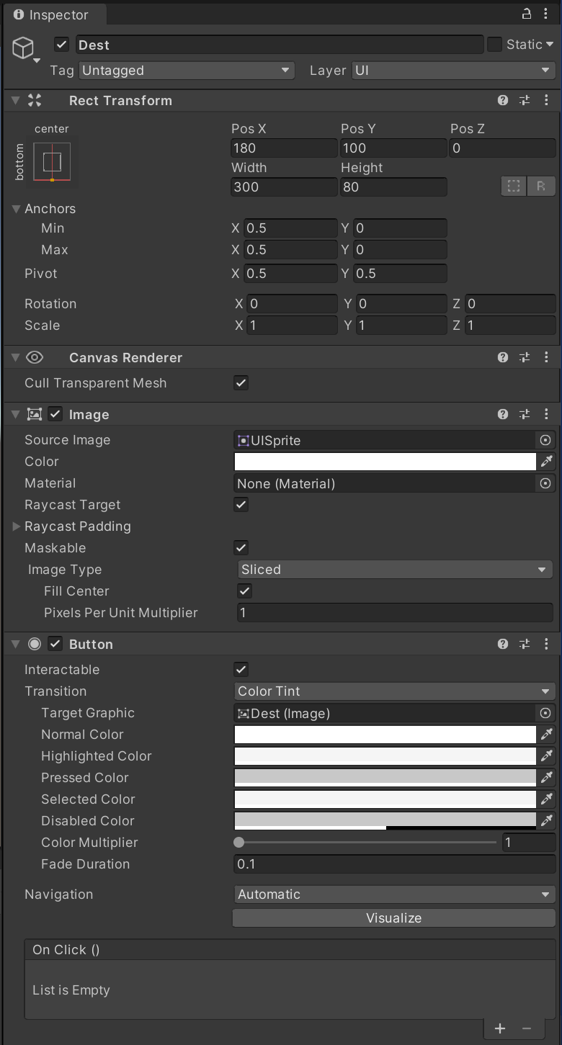
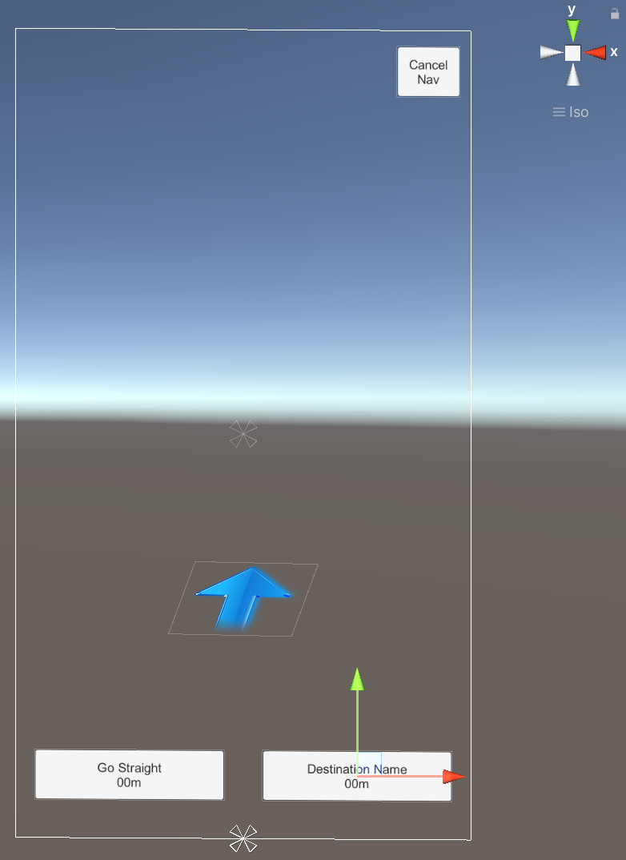
UI Development
3/9
List of Essential
UI component
List of Destination
Marker Recognition Guide UI
Marker Scan Button
Floor Change Image
Floor Change Button
Navigation Arrow
Cancel Navigation Button
.
.
.

Slide 6
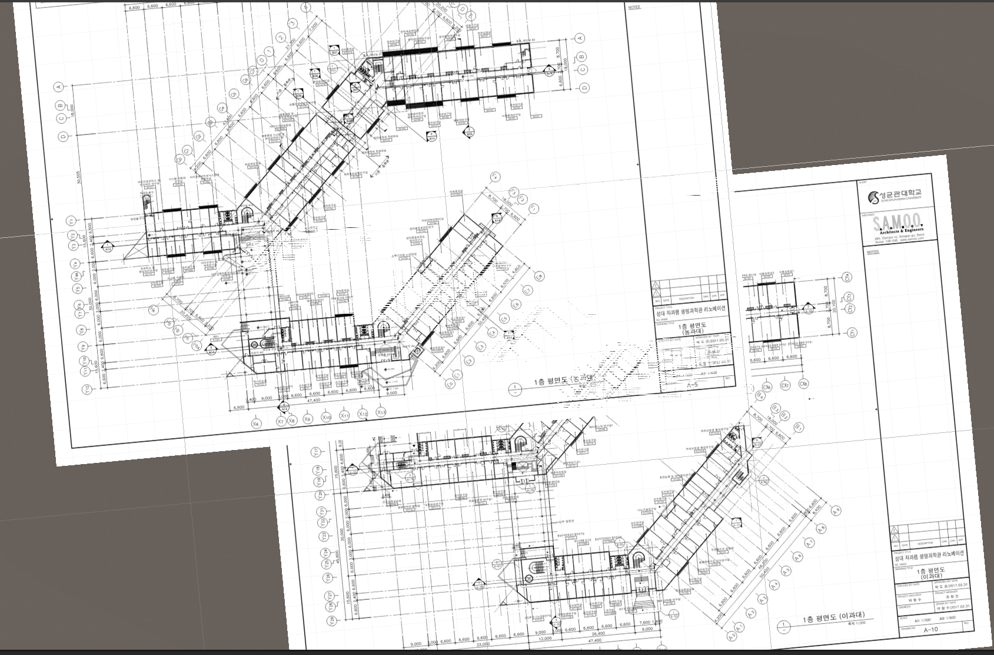
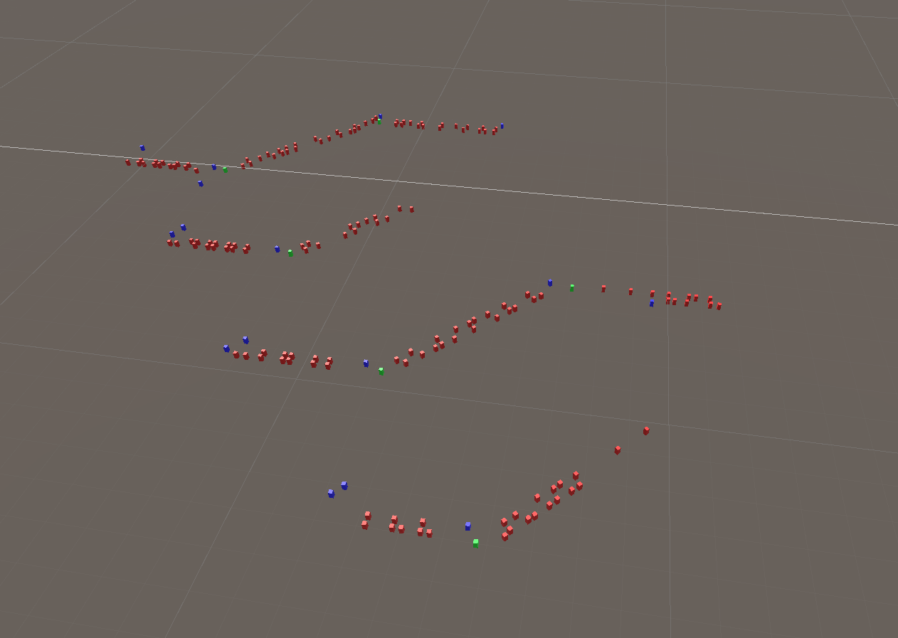
Location Correction
3/9
Data Example
ID: 51120
Floor: 1F
Adjacent corridor: 51A
Position: 25, 128
…….

Slide 7
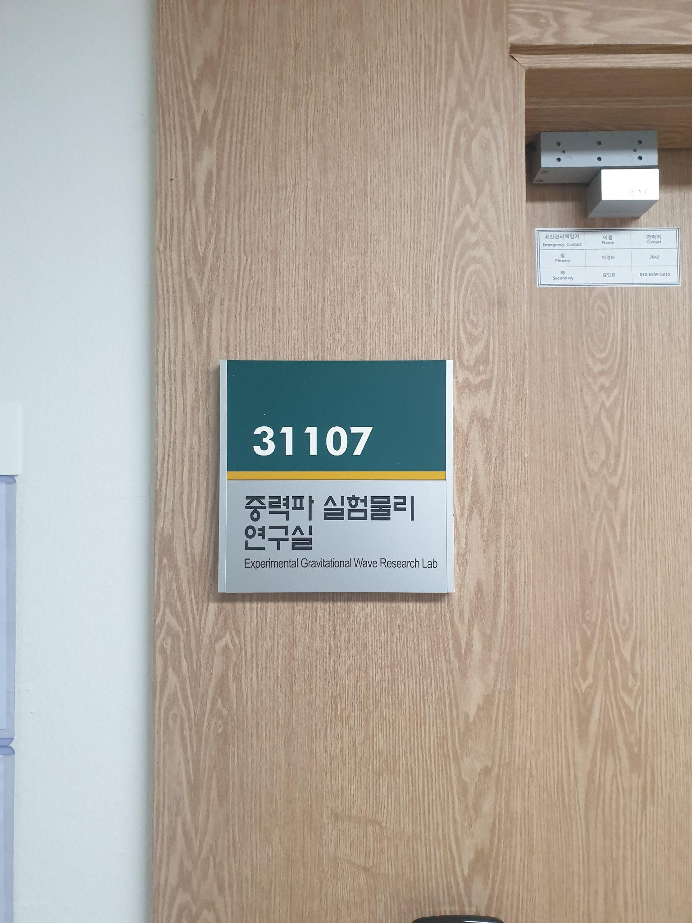
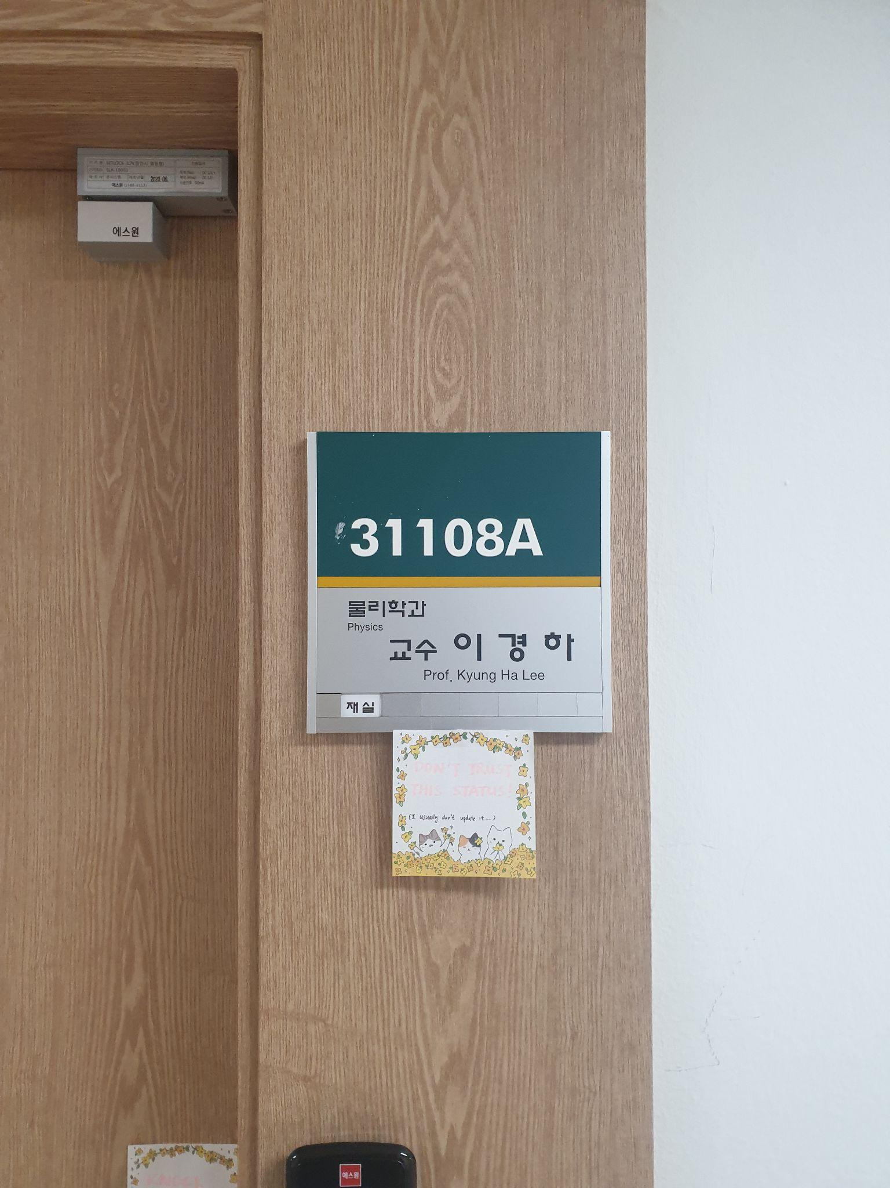
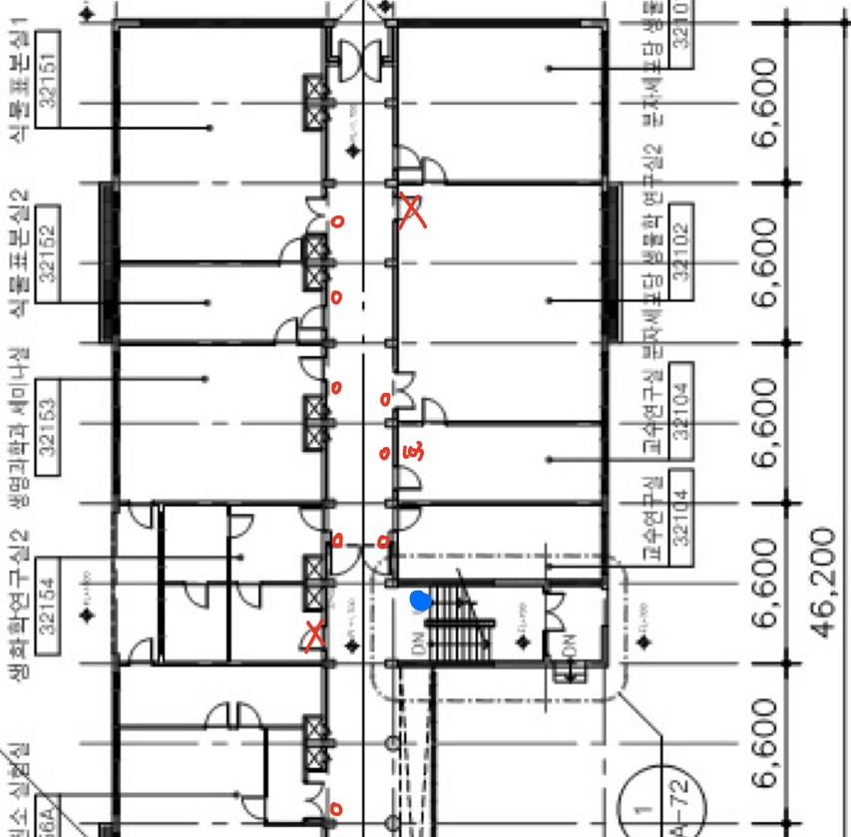
Location Correction
3/9

Slide 8





AR Marker recognition in Unity environment
5/9
load
processing

Slide 9



AR Marker recognition in Unity environment
5/9
load
processing

Slide 10
AR Marker recognition in Unity environment
5/9
texture
Mat

Slide 11
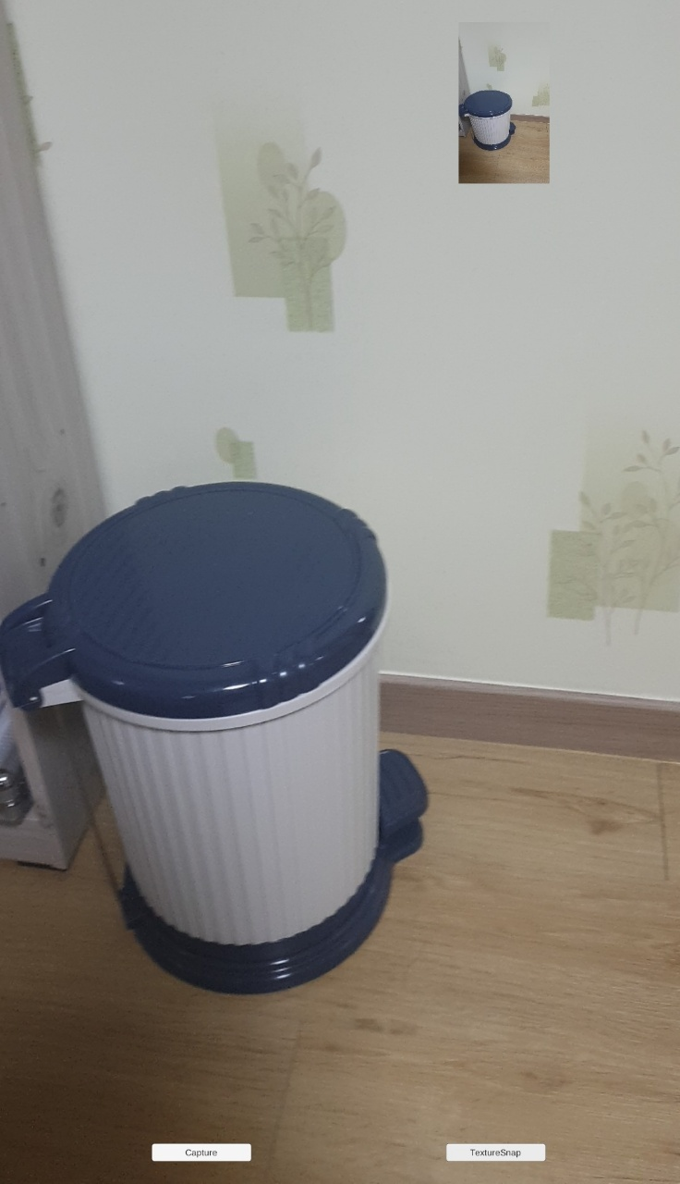
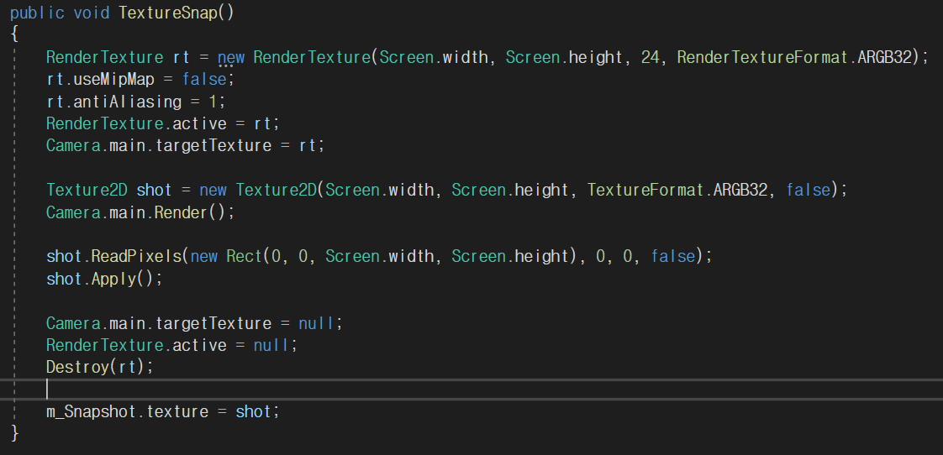
AR Marker recognition in Unity environment
5/9

Slide 12
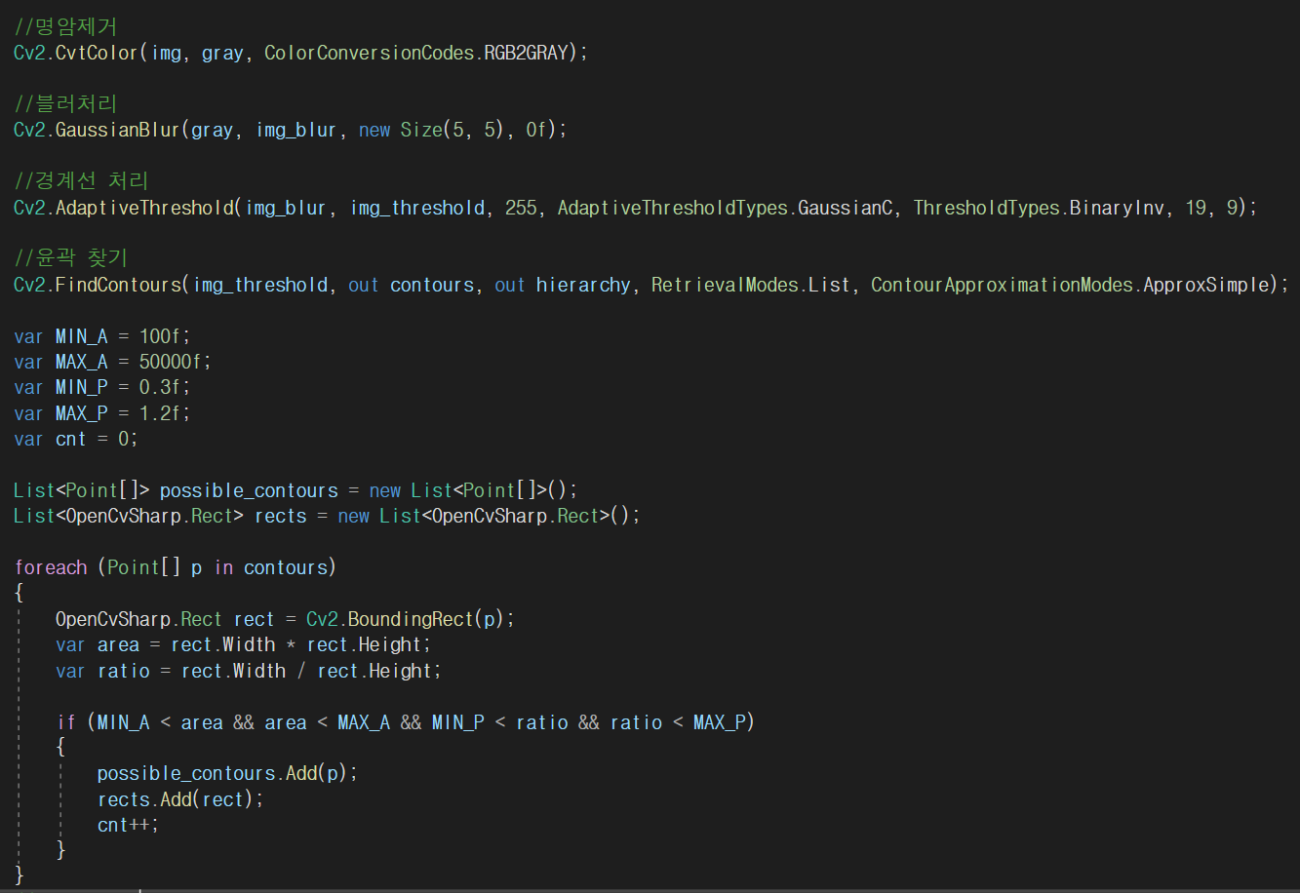
AR Marker recognition in Unity environment
5/9

Slide 13
AR Marker recognition in Unity environment
5/9

Slide 14
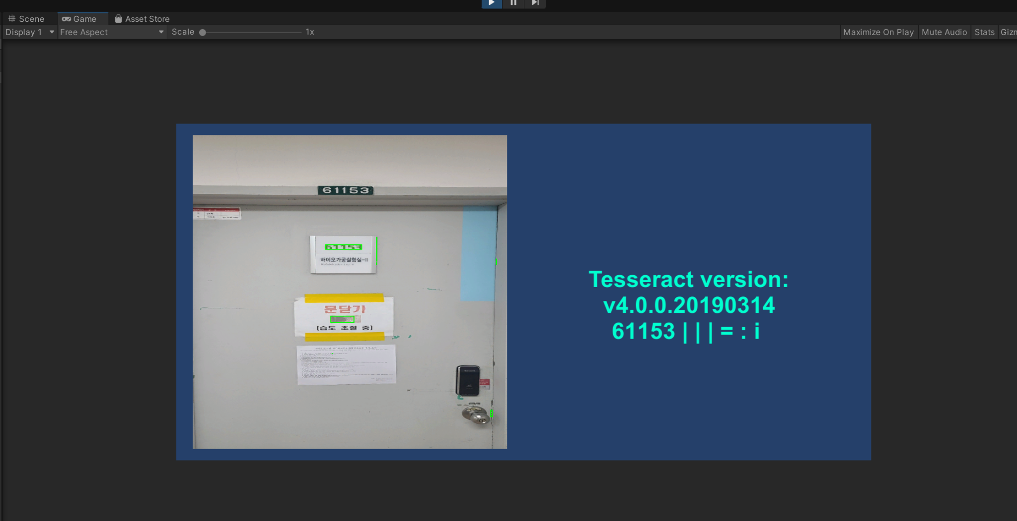
AR Marker recognition in Unity environment
5/9

Slide 15
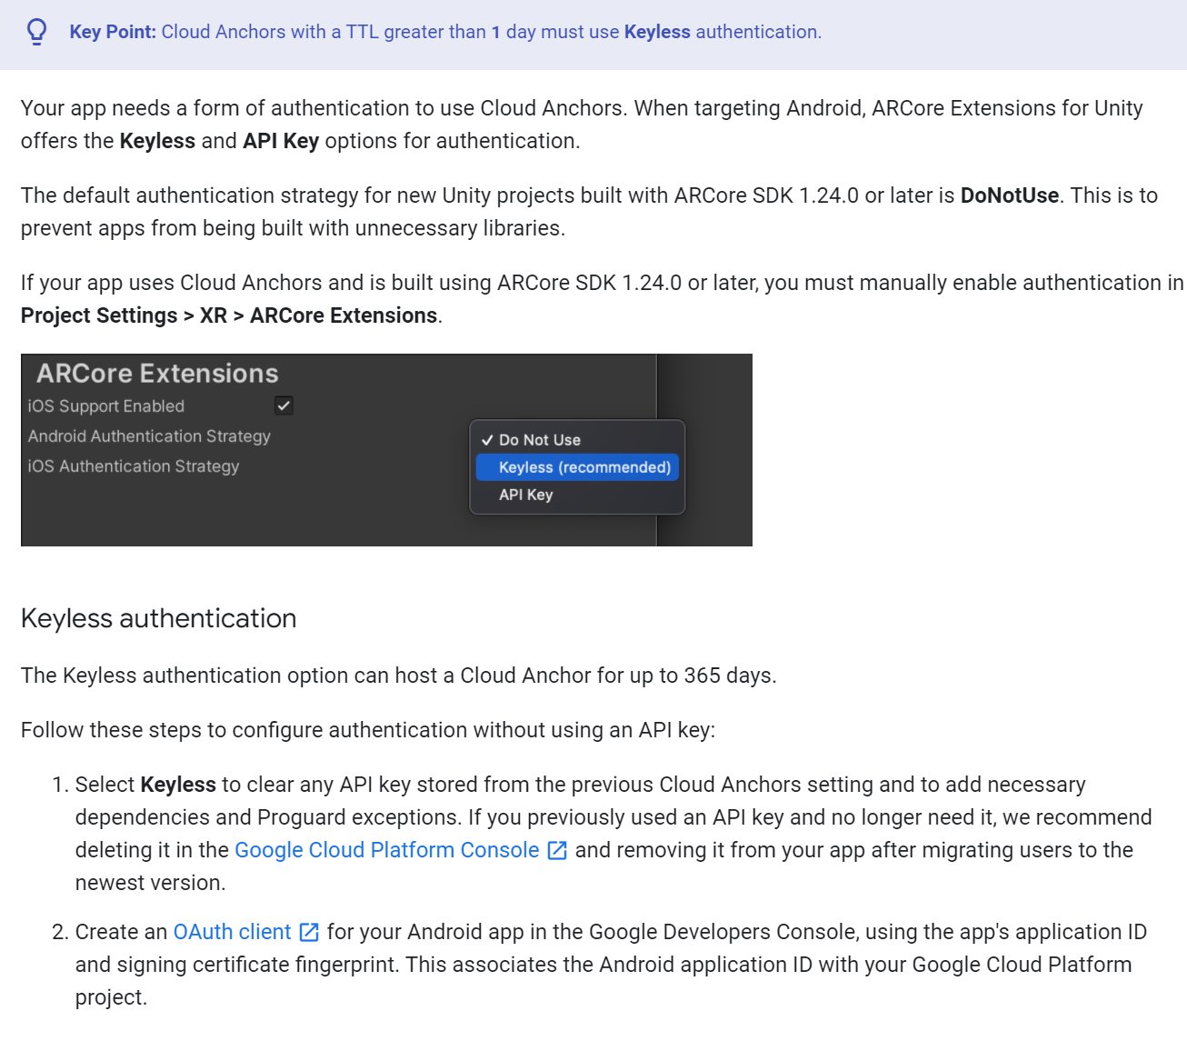
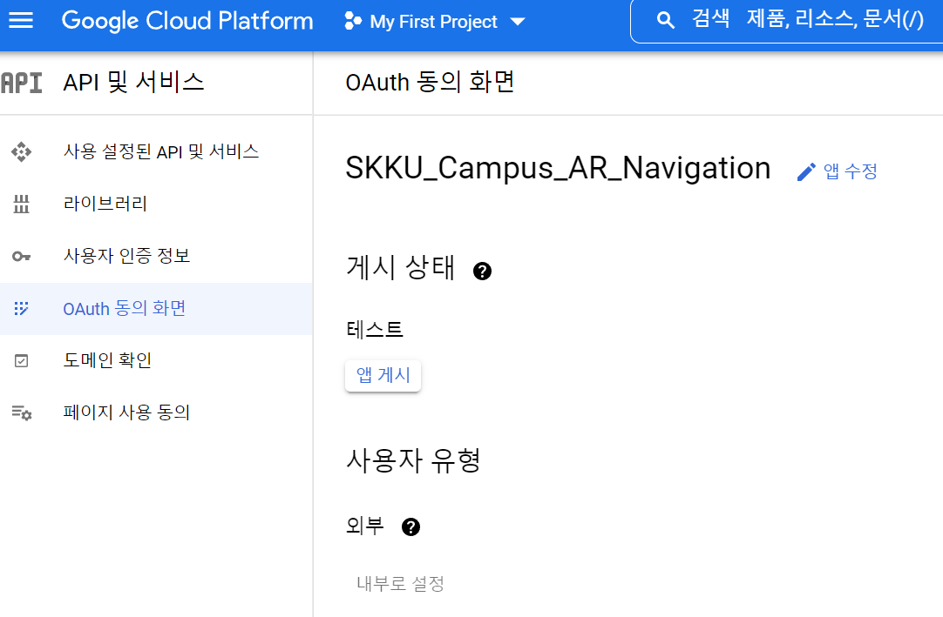
AR Anchor
7/9

Slide 16
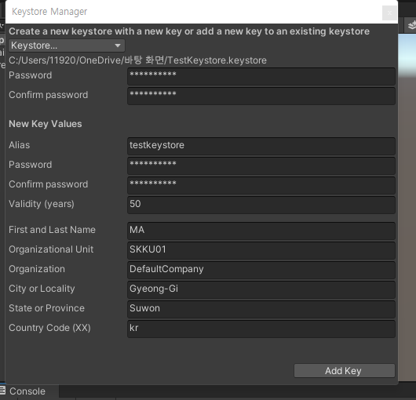
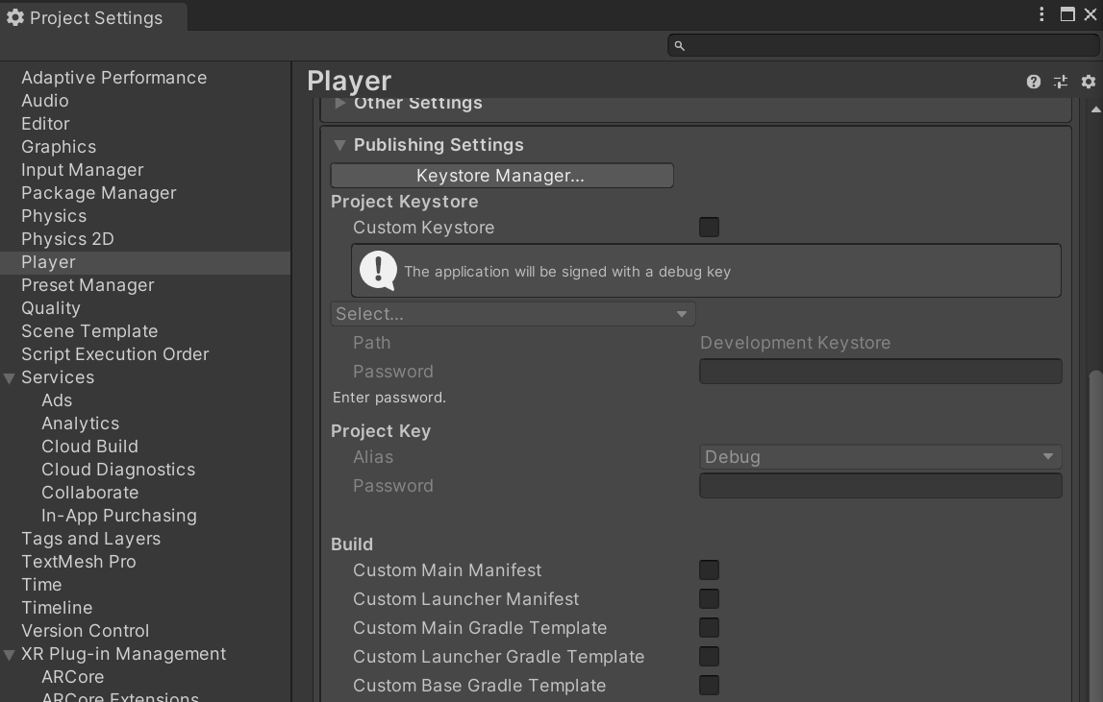
AR Anchor
7/9

Slide 17
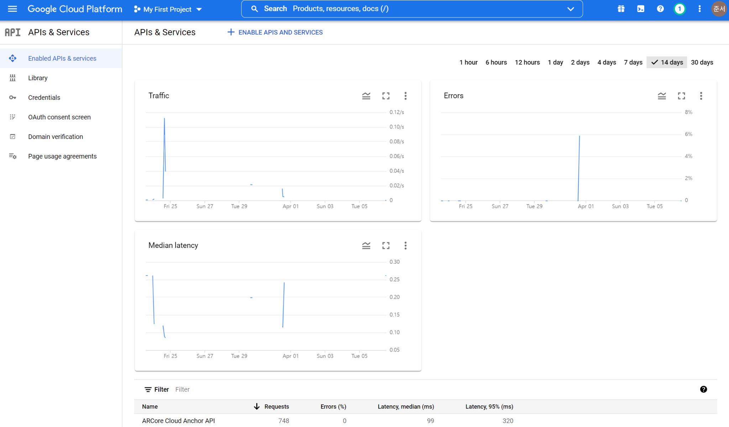
AR Anchor
7/9

Slide 18
To-do List Until Next Week
Front-end development(progressing)
Location correction & mapping (progressing)
Create Database
Find AR marker solution
Developer mode for host and share AR anchor
9/9

